Slide 1
Collecting personal memories in the Croatian Memorial and Documentation Center of the Homeland War
Julija Barunčić pletikosić, Ph.d.
Ivan radoš, ph.d.

Slide 2
Croatian Memorial and Documentation Center of the Homeland War
It is a central establishment concerned with the research of the Homeland War and the only specialized archive in Croatia that collects all the records from the Homeland War.
It has the mission to collect, arrange, safe keep, professionally and scientifically research and publish archive records from the Homeland War.

Slide 3
Methodology of collecting and processing memoir material in the Center
The Center also collects, preserves and processes memoir material from the period of the Homeland War and present records, memories, statements or similar sources of the direct participants of the Homeland War to the public, so that information about that period of Croatian contemporary history could be available to the researchers and to the general public.
This is important because these private notes, memories, statements and various records or studies of the participants of the Homeland War often reveal new and unknown events or new aspects of a known and already described event, which can be used to extend existing documents and records.

Slide 4
Memoir material can often be subjective, expressing one's own impressions about certain events or persons, so in accordance with that, we have to be careful in its use, i.e. try to compare it with existing official documents about the same event or at least other memoir material about the same event if it exists, such as the statements of several persons about the same event, person, etc.

Slide 5
Although it is defined as secondary historical material, that doesn’t reduce the fact that expressing one's own impressions and memories is important in the context of a more comprehensive and better understanding of the atmosphere of the period in question, or of an individual event, person, etc. The credibility of memoir material is all the greater if the content can be confirmed by other participants of the same event, i.e. official documents if they exist.

Slide 6
The Center's Collection of Memoirs (HR-HMDCDR, 17., Collection of Memoirs) contains a total of more than 830 hours of audio recordings.
As part of its publishing activities, the Center launched a special series of books under the title Republic of Croatia and the Homeland War 1990-1995. – memoir material. These books, based on the records of direct participants who most often collaborated with the Center as authors during publication, covered numerous topics from the Homeland War, for example the Croatian Navy, foreign volunteers in the defense of Croatia, the Bulwark of Love - Mothers for Peace, and certain military actions and operations…

Slide 7
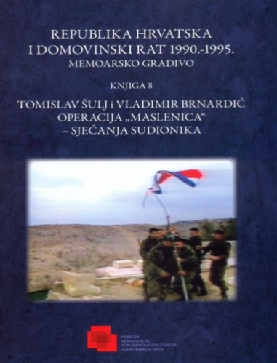
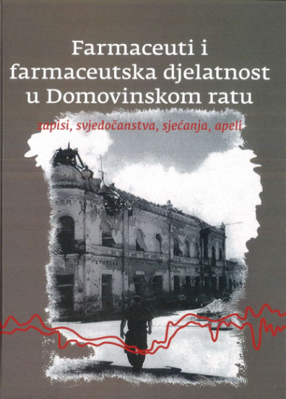
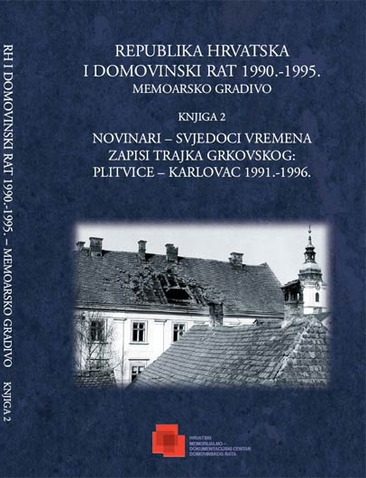
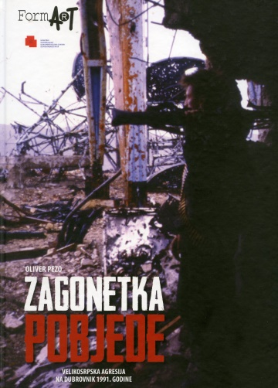
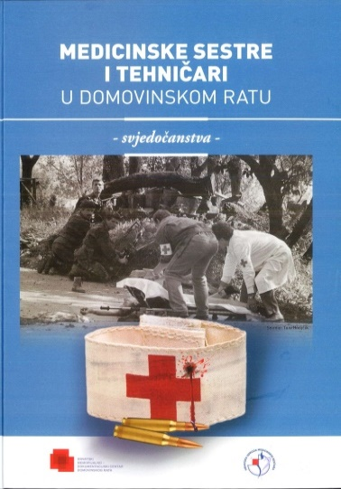
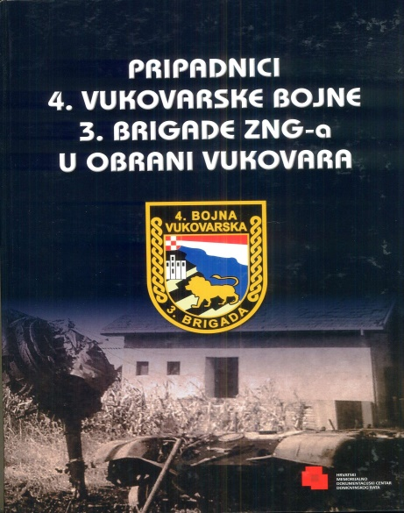
So far, the Center has published more than 25 titles in the mentioned series of memoir books.

Slide 8
The collected memoir material of the Center was also used as an important material and source of data for the filming several documentaries about the war (for example, the documentary film "1991, who is your neighbor" from 2021, about the participation of foreign volunteers in the defense of Croatia), and some documentary films were created in cooperation with Croatian Radio and Television - the two-part documentary film "Maslenica" (2013) and the documentary series "How Croatia was defended" (2016).
In addition to the further collection of memoir materials of private owners and the publication of a part of that material in the mentioned series of books and films, the Center uses the structured interview method in its collection of memoir material as a part of several projects in which it participated as a cooperating institution.

Slide 9
Oral history methodology
Oral history is a research method that uses clearly structured rules to collect, store, preserve, process and index the material collected in this way, i.e. human memories.
The term oral history includes a pre-prepared and designed questioning of an individual about a particular event or period in which he/she actively participated or witnessed it, i.e. recording these memories (audio and/or video).

Slide 10
But this way of collecting sources has certain disadvantages. Primarily because personal memories are subjective, and due to the limitations of human memory, they can be unreliable. The problem is also the fact that a human being selectively constructs memory, because each person tries to adapt his own memory to what he considers important.
There is also the possibility that the narrator interprets some memories based on other people's memories or tries to make his personal role in the events he describes more important than it was.
However, despite these shortcomings, oral history with proper use of documented sources can be very useful as a secondary research source.

Slide 11
Projects based on the oral history methodology
1. The Croatian Homeland War: Structures of Memory, project began at the end of 2012 and involved three institutions: the Ivo Pilar Institute of Social Sciences, the Center and the Croatian Institute of History - about 30 hours of audio and video material collected and stored in the Center and also transcribed.

Slide 12
2. From 2019 to 2021, the Center was an associate on an international scientific research project within the EU program HORIZON 2020 - Jihad or re-integration: pathways of foreign fighters after war, i.e. the Marie-Sklodowska Curie Fellowship project, which was sponsored by Leiden University - As part of that project, the Center conducted 25 structured interviews with foreign volunteers of the Homeland War, which were used for the research purposes of the project. The interviews were processed, transcribed and stored in the Center.

Slide 13
3. From war to peace: Croatian War Veterans in Transition
Through the four-year research, it is planned to carry out a larger number of structured interviews with different profiles of Croatian Veterans, and also to create a systematized presentation of the research results, on which the writing of the monograph as well as individual scientific articles will be based.

Slide 14
Personal memories as one of the sources for the reconstruction of events from the Homeland War
numerous studies have shown that war memories occupy perhaps the most significant and lasting impressions on people
many research/scientific branches (sociology, psychology, anthropology...), including history, are interested in memories as a concept of past reconstruction
memories are an important part of the overall narrative and knowledge about the Homeland War

Slide 15
Examples of use
an excellent aid in the reconstruction of past events
the importance of clarifying and approaching events for which there are not enough classic historical sources (for various reasons - lack of time, institutions and forms of storage, professional staff, the necessity of defense at that moment)
international recognition of Croatia (interview with the then Minister of Foreign Affairs D. Rudolf, revealed the important circumstances and context of those events...)
several books about Vukovar based on memoirs and memories
the history of certain groups or an events outside the primary focus
documentary films etc.

Slide 16
Conclusion
Memories (although not a primary source) as a valuable complement to the understanding of certain historical processes, events or help in studying the history "from below" of certain groups or phenomena (which are often not of primary interest).
The activity of the Center developed from simpler to more complex undertakings and projects
Acquired materials and acquired experiences were used for the reconstruction of the history of the Homeland War (books, documentary films, scientific and other projects...).
Past efforts and experience have shown the justification and importance of interdisciplinary and inter-institutional cooperation.

