Slide 1
„Reviving“ the memory; foreign volunteers in the Croatian forces (1991.-1995.)
Title: „We defended Croatia, don't forget us”
Oral history method; important source

Slide 2
Attractive topic; neglected in Croatia / change of global narrative at the end of the 20 century
„Dogs of war”, Daily Telegraph 1991.
„Foreign volunteers”, Telegraph 2023.

Slide 3
The result of stereotypes and negative images - the road to oblivion
1. Croatia government got rid of foreigners 1992.
2. Negative image; „dogs of war” or ruthles mercenaries
3. Numerous problems after returning to homelands
Result: closed group of war veterans

Slide 4
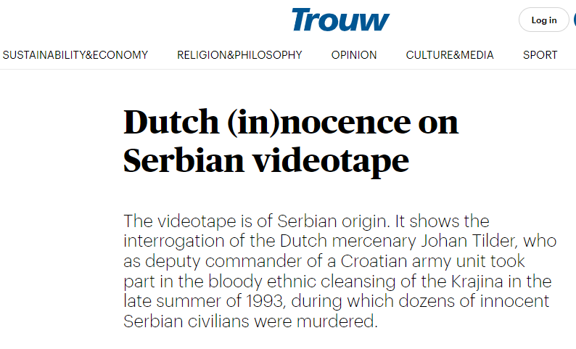
The most radical consequence of untruths published in the media
Based on accusations by the Serbian media, 13 Dutch were charged for war crimes, which happened two years after they left Croatia
12 years of media persecution, 4 investigative procedure
Charges dismissed 2009. - the Dutch volunteers still suffer public condemnation

Slide 5
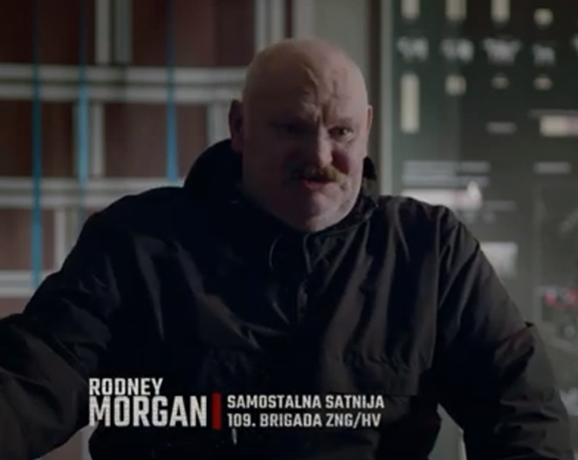
Example of R. Morgan; socially rejected due to untruths in the media

Slide 6
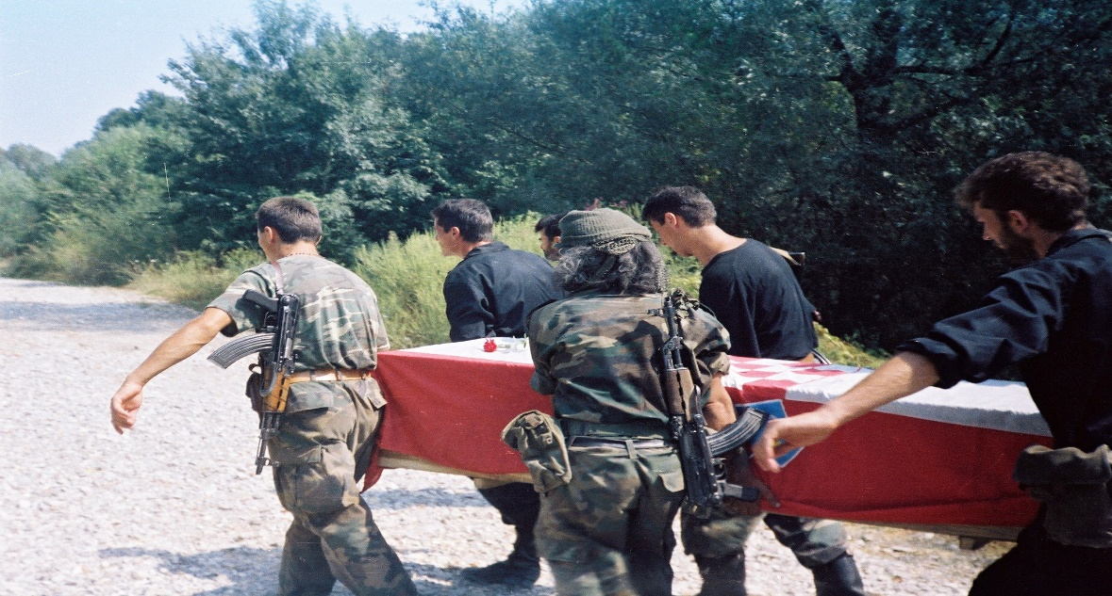
15 years of interviewing and collecting sources; results
More than 800 volunteers from 44 countries
85 killed in battle, more than 150 wounded
Special war conflict of the 20th century

Slide 7
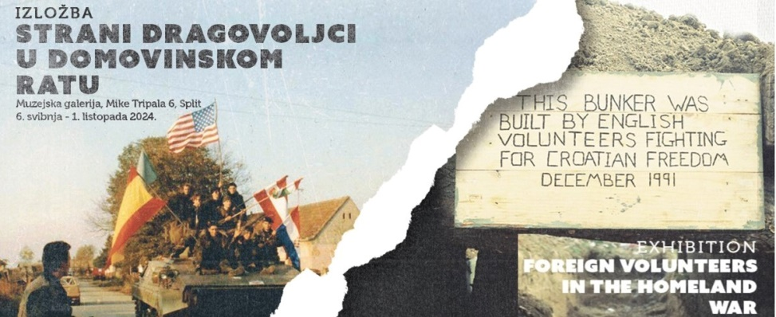
From oblivion to great public interest
„Forgotten“ for 20 years
Collecting sources and memories (interviews) revived social attention
Today presence: media, literature, books, museum exhibits, documentary movies, etc.

Slide 8
The Leiden University project as an indicator of the difficulty of accessing a closed group of war veterans
The aim was to research the phenomenon of the foreigners in the modern wars
None of foreign volunteers wanted to give an interview
Involving a trusted person resulted with 25 interviews

Slide 9
- Foreign volunteers; radical example of the traumatic post-war transition - Traumatic transition for many war veterans
Forgotten by Croatian society
Croatia did not solve their status problems, not even the right to have a health care
Problematic returns to homelands
Croatian war veterans also suffer problems and traumas in the transition period
Missed fact that post-war traumas could make for some veterans more serious consequences than memories of war traumas.

Slide 10
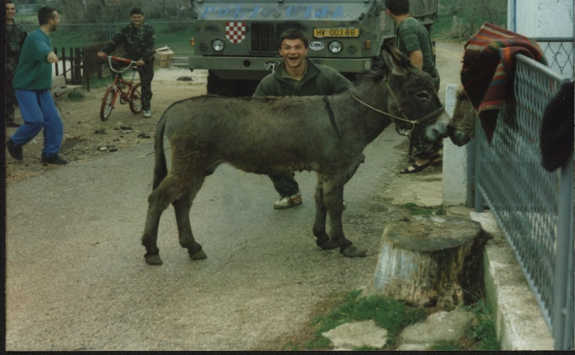
Why we missed the fact about hard transition into civil life?
The previous questions were mostly based on wartime memories
A different approach in the new project; focus is on the post-war transition
New perspective: much easier to talk about the war than about the post-war transition

Slide 11
The questions about civilian transition in war veterans cause dissatisfaction
B sector transition into civilian life
C & D work of veterans' associations and state care institutions for veterans
E state holidays and state care for memory on war traditions
F veterans' right to public activism and protests
G work of the Hague Tribunal
H attitude of society towards war veterans and the values ​​of the Homeland War
I present and the future (PTSD, suicides, health problems)
B dissatisfaction
C dissatisfaction
D dissatisfaction
E dissatisfaction, confusion
F dissatisfaction, confusion
G dissatisfaction, anger
H dissatisfaction, sadness
I dissatisfaction, anger

Slide 12
Shortcomings, results, future possibilities of the Questionnaire
Too many difficult questions, which affect veterans' feelings and cause stress
Positive reactions even from veterans with hard form of PTSD
Positive ansvers on the last question: "Do you think it is useful to conduct such interviews for final result of the project?”
Conclusion: Despite all the difficulties and stress, positive reactions should give an additional motivation to continue conducting interwievs

