Slide 1

The Republic of North Macedonia
SKOPJE from 6/9/2021-10/9/2021
Assoc. Prof. Zorana Šuljug Vučica, PhD
Assoc. Prof. Gorana Bandalović, PhD

Slide 2
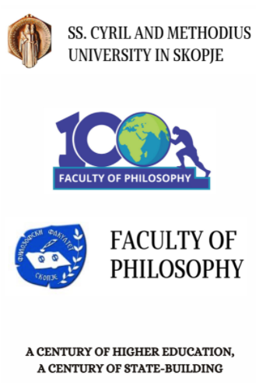
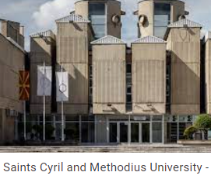
The Faculty of Philosophy in Skopje was founded in 1920.
Today, the Faculty of Philosophy is a modern, interdisciplinary faculty consisting of 12 institutes of humanities and social sciences.
Study programs offer BA, MA and PhD degrees in the following disciplines: philosophy, history, pedagogy, sociology, classical studies, history of art and archeology, psychology, social work and social policy, special education and rehabilitation, security defense and peace, gender studies, and family studies.
http://fzf.ukim.edu.mk/
At the Institute of Sociology, sociology is taught at all levels of study – first, second and third, in accordance with the European Credit Transfer System (ECTS)

Slide 3
Overall objectives of the mobility for training at the Faculty of Philosophy in Skopje:
to get insight into the sociological and teaching strategies applied and used in undergraduate and graduate programmes of sociology at the receiving institution
to get detailed insight into curriculum development strategies used in higher education
to get acquainted with scientific (research) projects in the field of sociology as well as with used methodological skills, developments and trends

Slide 4
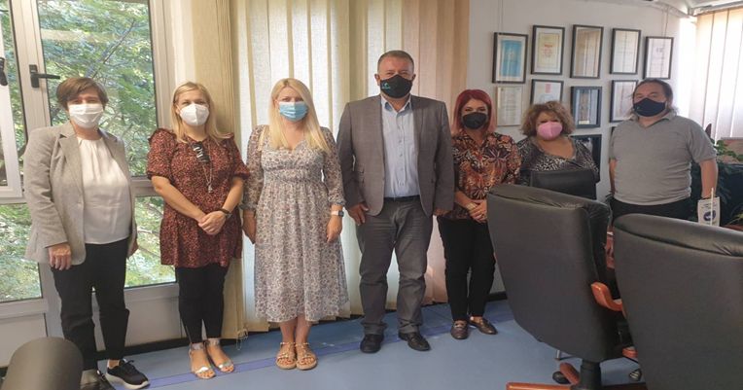
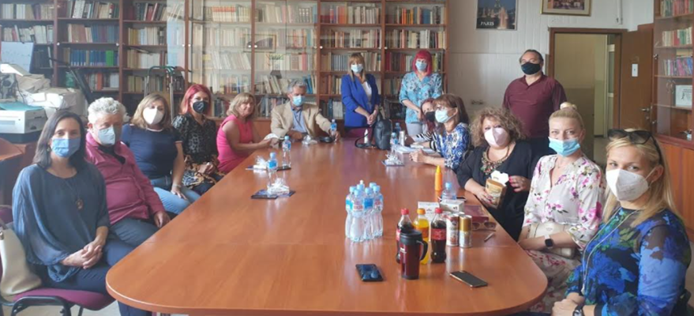
Activities and results
At the Faculty of Philosophy in Skopje:
We had meetings with the Dean Ratko Duev, Vice Dean for Research and International Cooperation Maja Gerovska Mitev and colleagues from the Department of Sociology (http://fzf.ukim.edu.mk/en/institute-of-sociology/)
We discussed different topics regarding differences and similarities between two faculties, social problems we faced such as education and teaching in the period of pandemic, possibilies of mobility, etc.
We also discussed possible future aspects of cooperation such as (mobility, conferences, summer schools programmes, research work, projects, etc.)

Slide 5
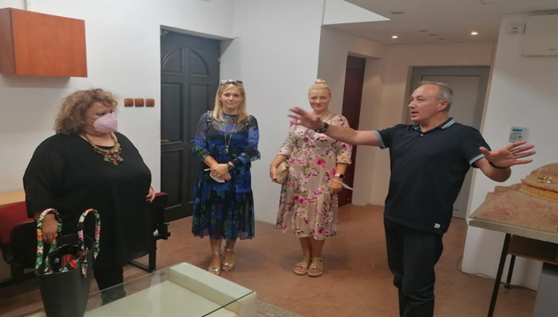
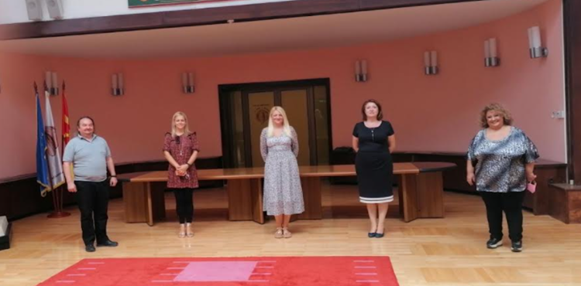
We visited the Archaeological Museum Collection within the Institute of Art History and Archaeology and enjoyed in the presentations of artefacts and stories from the history of North Macedonia.
We also visited Ss. Cyril and Methodius University and had a meeting with Vice Rector Hristia Spasevska, Full Prof.

Slide 6
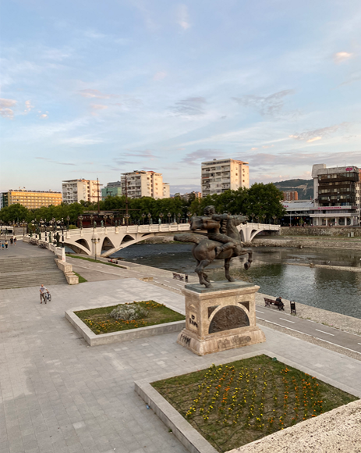
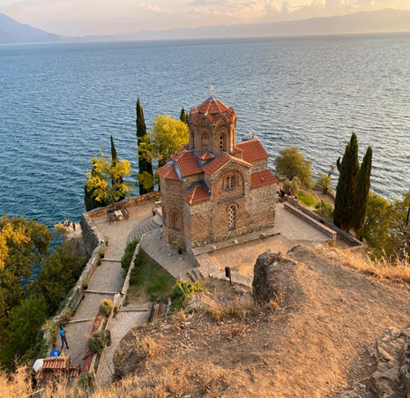
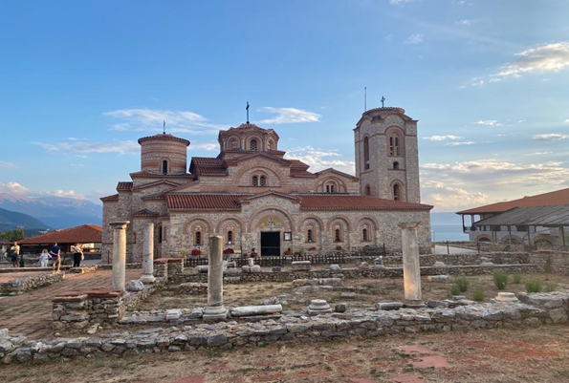
During the stay, we worked on collaboration between two faculties (especially two Departments of Sociology) and on possible joined research activities.
We enjoyed in organized visiting tours in Skopje, Ohrid and Gevgelija and were fascinated by varieties of cultures and traditions of the Republic of North Macedonia.

